Slide 1
Microflow Basics

Slide 2
Microflows and Nanoflows
Microflows are used to add logic to Mendix apps
Rather than writing code, you can create logic by constructing flow diagrams using BPMN
You can create complex logic that includes branching, loops, data retrieval and manipulation, etc
A nanoflow is similar to a microflow but cannot interact with the databse
The desktop modeler includes an integrated debugger for microflows

Slide 3
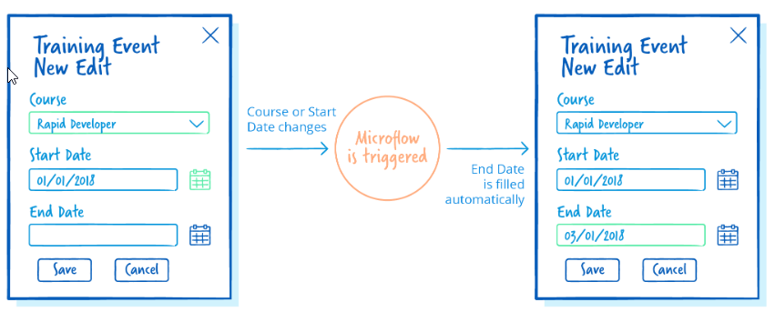
For example, this application allows the user to schedule a training event. The course has a predetermined length so when the user enters the start date, the end date can be automatically calculated. The date picker for start date has a change event which triggers the microflow.

Slide 4
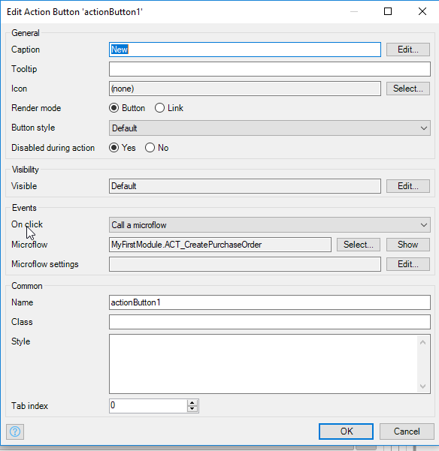
Button Events

Slide 5
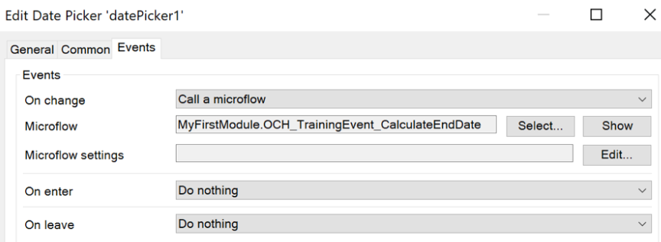
Widget Events
On enter: when the user enters (clicks on) the input widget
On change: when the user leaves the input widget after making a change
On leave: when the user leaves (closes) the input widget (no matter whether they changed the value of the widget or not)

Slide 6
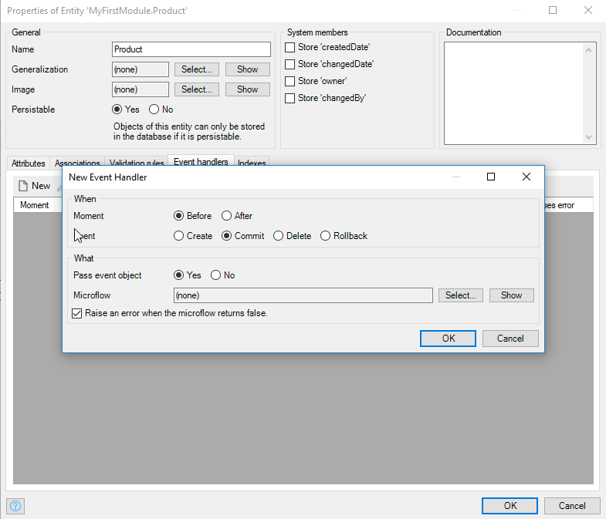
Entity Events
Entity events are attached to entities in the domain model. The microflow runs either before or after a record is created, committed, deleted or rolled back

Slide 7

Microflow Objects
Annotation
Loop
Activity
Splits
Events
Parameter

Slide 8
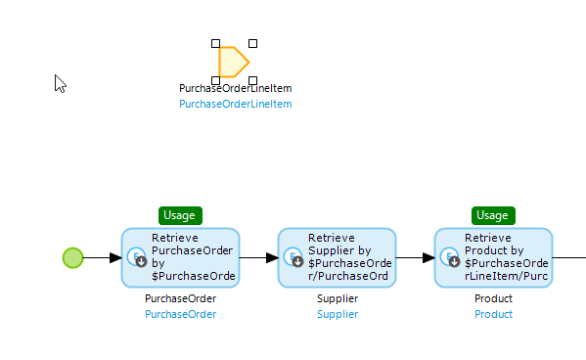
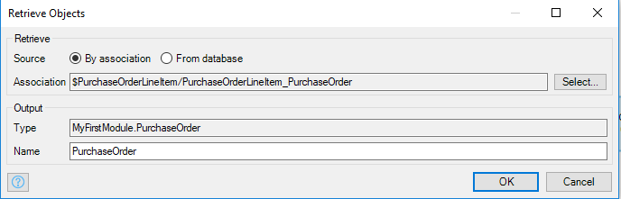
Parameters or Variables
Variables contain values. If you call a microflow from within a context that contains an object (database entity for example) the object is automatically passed in to the microflow.
The variable is available to every activity in the microflow
If you select the variable, you will see the green Usage tag everywhere the variable is used
Activities can also create variables

Slide 9
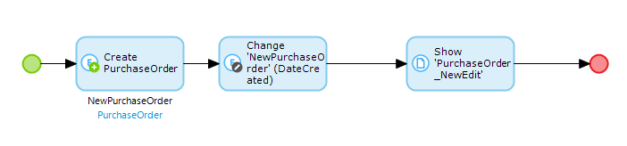
Create PO Microflow
Logic flows from the start event to one of the end events
Activities provide the functionality
A microflow must have at least one end event but can contain multiple end events
Every microflow must have one, and only one start event

Slide 10
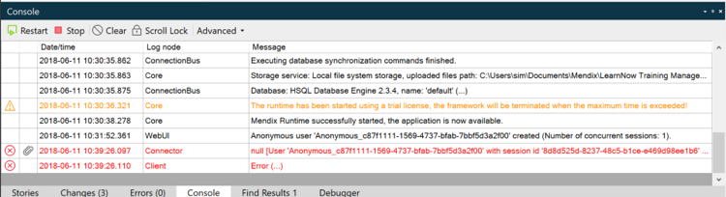
Analyze Errors
Microflow errors are shown in the Console. Double-click the error to get more information about it.

Slide 11
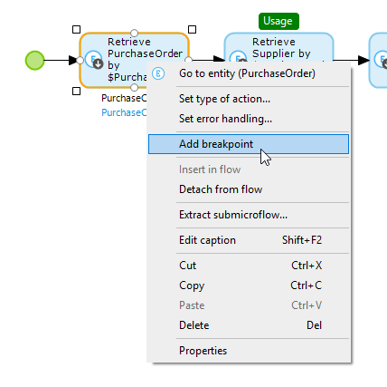
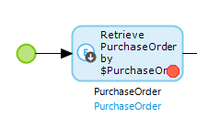
Debugging
You can add or delete a breakpoint on an activity by right-clicking it
The execution of the microflow will pause at that point and allow you to examine variable values

Slide 12
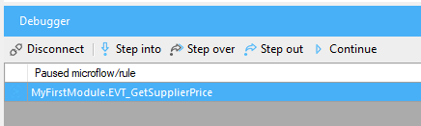
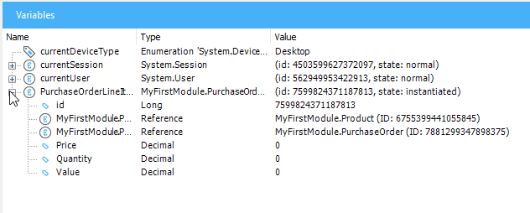
Debugging
You can step through the activities of the microflow
And examine the values of variables

